Slide 1
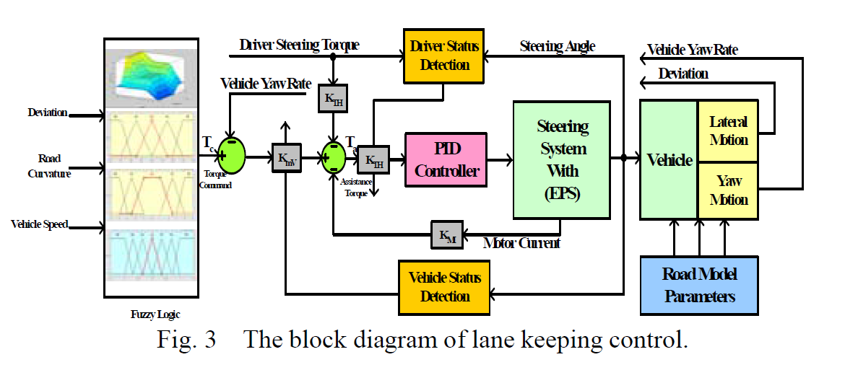
LKA control structure (MOEA Taiwan)

Slide 2
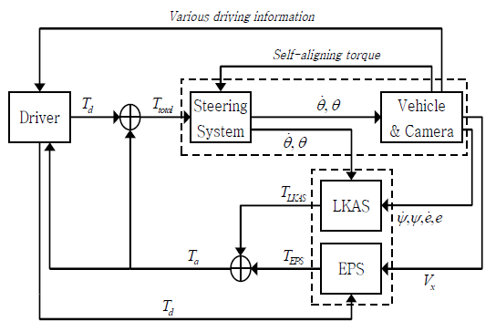
LKA control structure (IFAC Korea)

